Slide 1
HUMAN RIGHTS: RACIAL PROFILING
Student Name
Course Number
Due Date

Slide 2
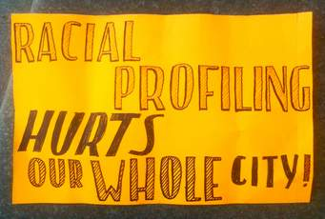
Introduction
Human rights refer to the basic rights as well as freedom which belong to each person around the globe from birth till death.
Racial profiling is a long standing as well deeply troubling national issues that is impacting human rights.
the police and the security personnel mainly aim at the black people for humiliation and mostly frightening detentions, interviews as well as searches with no prove of criminal conduct

Slide 3
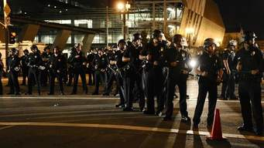
Police Discretion and Racial profiling
Racial bias cannot be evaded when the society’s image of a criminal is an African American male.
The police tend to have an incredible level of discretion on who to target.
The white people are not considered to be criminals.
This discretion results to many black people to be held in prison by the police (Ontario Human Rights Commission, 2017).

Slide 4
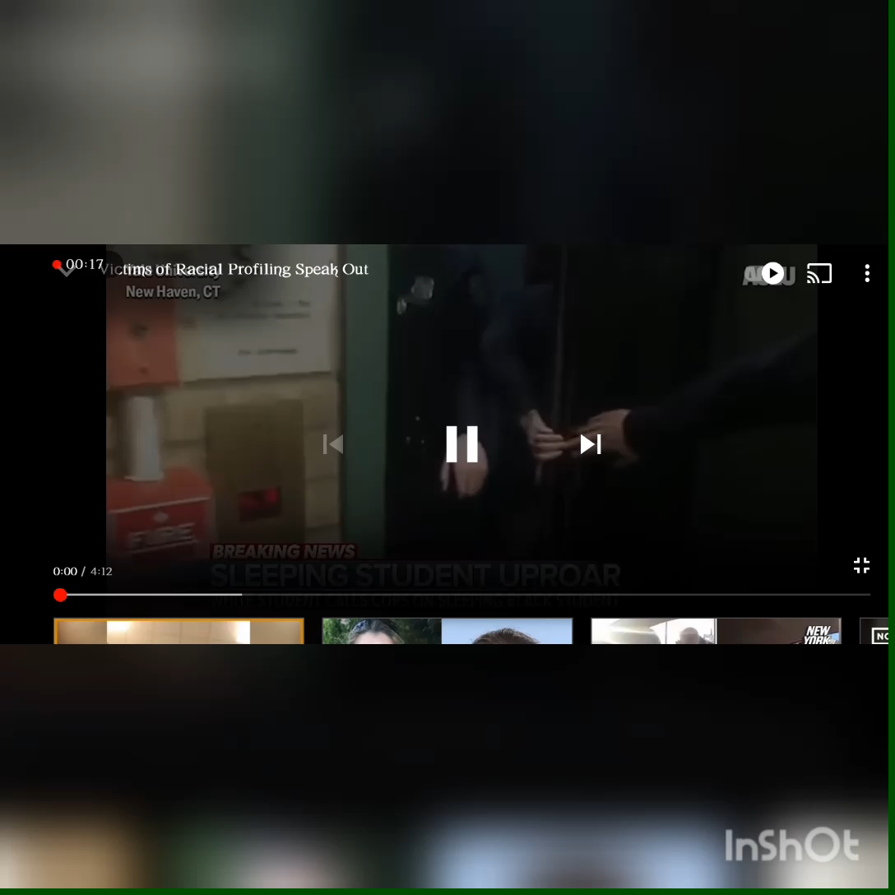
Impact of Racial profiling
It compromises our future due to the loss of educational opportunity for the children.
Creates mistrust of the institutions both in the children and adults of the key institutions. It washes away the public confidence in the institutions
Racial profiling creates community divisions as well as unwillingness to identify one’s community (ACLU, 2021).

Slide 5
Conclusion
Racial profiling tends to undermine the relationship between police and the racialized ad indigenous people.
It minimizes the ability of the affected individuals to report crime, cooperate with the police and may others.
This mistrust tends to undermine the efficiency as well as the authority of the institutions.

Slide 6
References
ACLU. (2021). Racial Profiling. Retrieved from https://www.aclu.org/issues/racial-justice/race-and-criminal-justice/racial-profiling
Ontario Human Rights Commission. (2017). Under Suspicion: Concerns About Racial Profiling by Police. Retrieved from http://www.ohrc.on.ca/en/under-suspicion-concerns-about-racial-profiling-police

